Slide 1



NATURE’S
NEST
Wooden art celebrates the inherent beauty of wood, showcasing its natural grains and patterns.Wooden art encompasses a vast range of styles, from traditional carvings to modern abstract pieces.
MANDEEP KAUR
BCA
LPU

Slide 2

COMPANY PROFILE
O7 Services is ISO 9001:2015 Certified company founded in 2015. They specialise in a variety of services including Web Development, Mobile Application Development, Custom Software Development, UI/UX Designing, Hosting services, Digital Marketing, Registration of Domain Names with various extensions, AMC & MMC Services, Bulk SMS and voice calls. O7 Services offers advanced IT solutions supporting the entire business cycle - from consulting to system development, deployment, quality assurance, and 24x7 support. With over 9 years of experience, the company aims to form long-lasting strategic partnerships with clients, offering affordable prices, timely delivery, and measurable business results. Their headquarter is located in Jalandhar with a branch office in Hoshiarpur

Slide 3

AGENDA
TABLE OF CONTENT
01
06
Front End and Back End Technology
Introduction
02
07
Existing System
Data Flow Diagrams
03
Proposed System
08
Screenshots & The Craftsmanship Process
04
Project Description
09
Conclusion
05
10
Modules
Future Scope

Slide 4
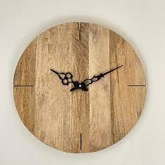
INTRODUCTION
It is the website of unique collection of handcrafted
wooden art pieces.
Artistic creations from wood.
Show the natural beauty and versatility of material.
Types include sculptures, carvings, furniture, wall art and decorative objects.
There are two panels include : Admin and Customer
.

Slide 5
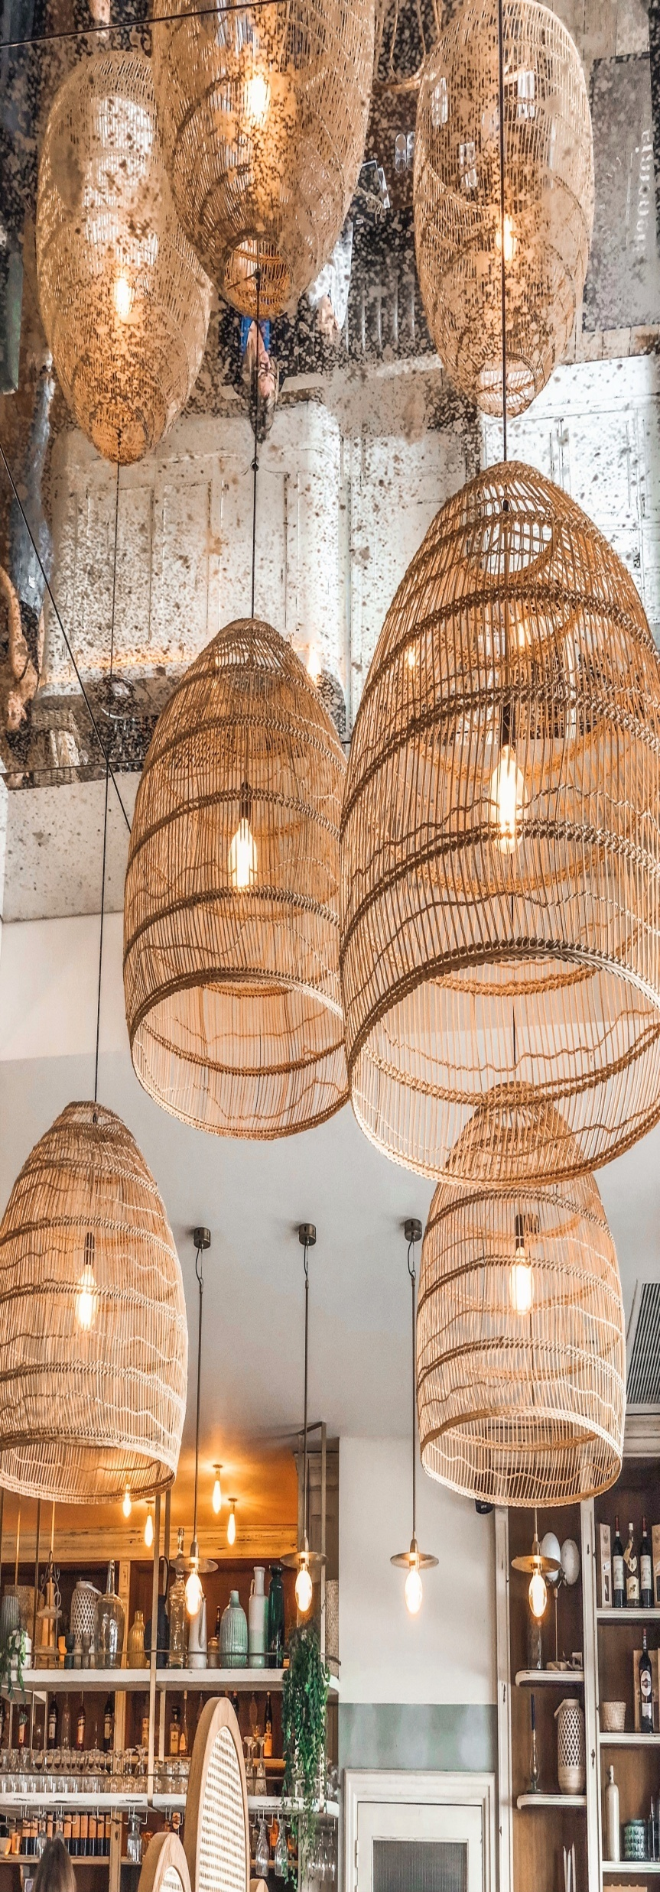
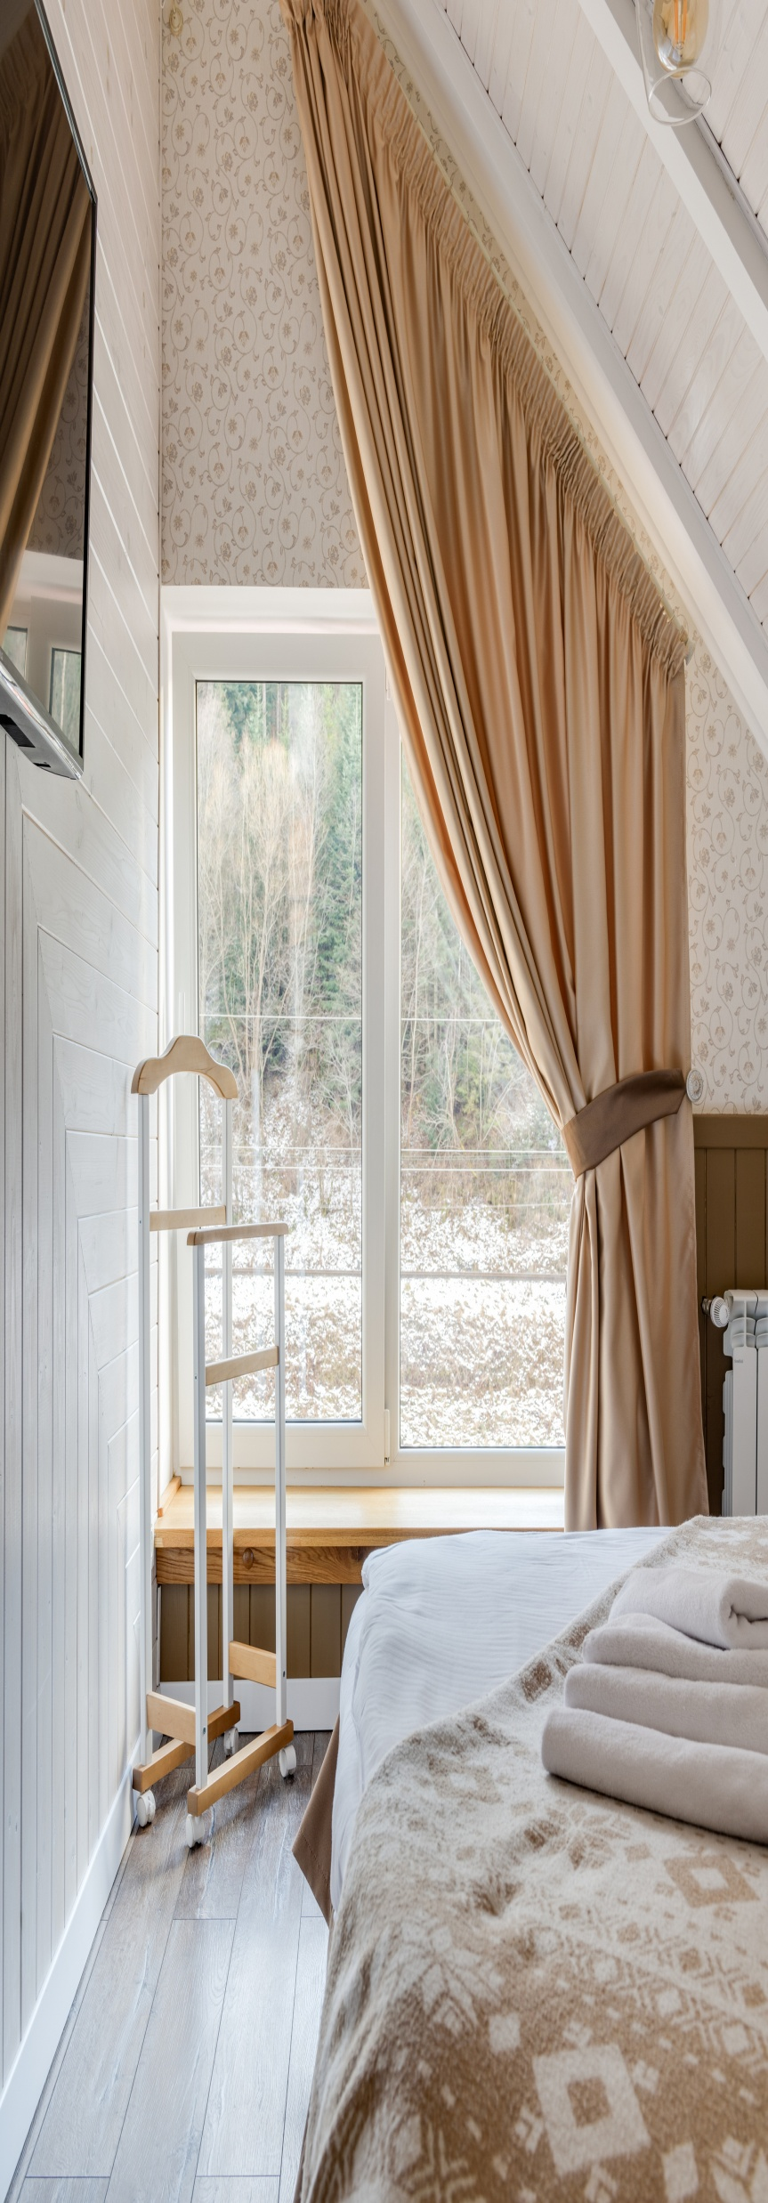
Existing System
POOR NAVIGATION
CUSTOMIZATION QUERIES
INSUFFICIENT PRODUCT DESCRIPTIONS
DATA SECURITY
SUSTAINABILITY

Slide 6
Proposed System
ORDER HISTORY
UPDATE PREVIOUS WORK
MARKET EXPANSION
AUTOMATE UPDATES & CUSTOM TEMPLATES
DETAILED DESCRIPTION

Slide 7


PROJECT DESCRIPTION
ADMIN
CUSTOMER
The Admin panel is designed for website administrators who
manages overall operation of
website.
The Customer panel is for users who are interested in purchasing the wooden art pieces from the website.

Slide 8



MODULES
ADMIN
CUSTOMER

Slide 9

MODULES
ADMIN |  | CUSTOMER
LOGIN
MANAGE CUSTOMERS
LIST OF CUSTOMERS
ART PIECES & DESIGN
VIEW UPLOAD BOOKING
WITH COSTING
MANAGE CATEGORY
REGISTER
LOGIN
MANAGE PROFILE
VIEW ART PIECES & DESIGN
ADD/VIEW/UPDATE BOOKING
VIEW POSTED WORK

Slide 10


DATA FLOW
DIAGRAMS

Slide 11

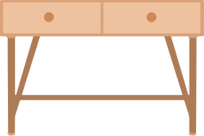
DATA FLOW
DIAGRAM-LEVEL 0
NATURE’S
NEST
ADMIN
CUSTOMER

Slide 12

DATA FLOW
DIAGRAM-ADMIN
 | USERS
MANAGE
CUSTOMERS
ADMIN
IS LOGGED
IN?
 | BOOKING
UPDATE/VIEW
BOOKING WITH COSTING
YES
 | ART PIECES
MANAGE
ART PIECES
 | DESIGNS
DESIGN
ART PIECES
MANAGE DESIGNS

Slide 13
DATA FLOW
DIAGRAM-CUSTOMER
 | USERS
UPDATE
PROFILE
CUSTOMER
IS LOGGED
IN?
 | ART PIECES
ART
PIECES
YES
CUSTOMER
BOOK OUR
ORDERS
 | BOOKINGS
 | DESIGNS
VIEW
DESIGNS

Slide 14





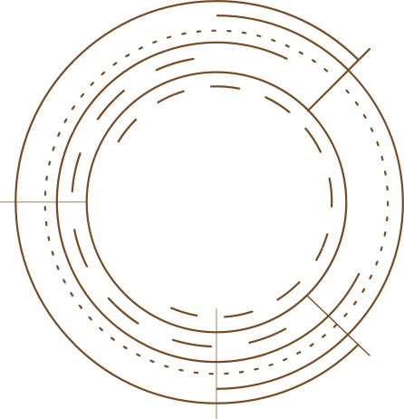

FRONT END TECHNOLOGY
HTML
CSS
JAVASCRIPT
ANGULAR
BOOTSTRAP

Slide 15



BACK END TECHNOLOGY
BACKEND
FIRESTORE / FIREBASE
FILE STORAGE
CLOUDINARY

Slide 16
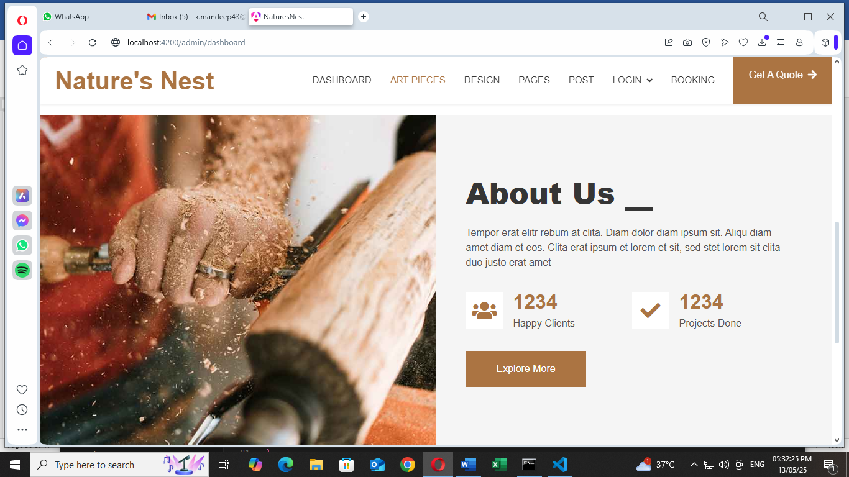
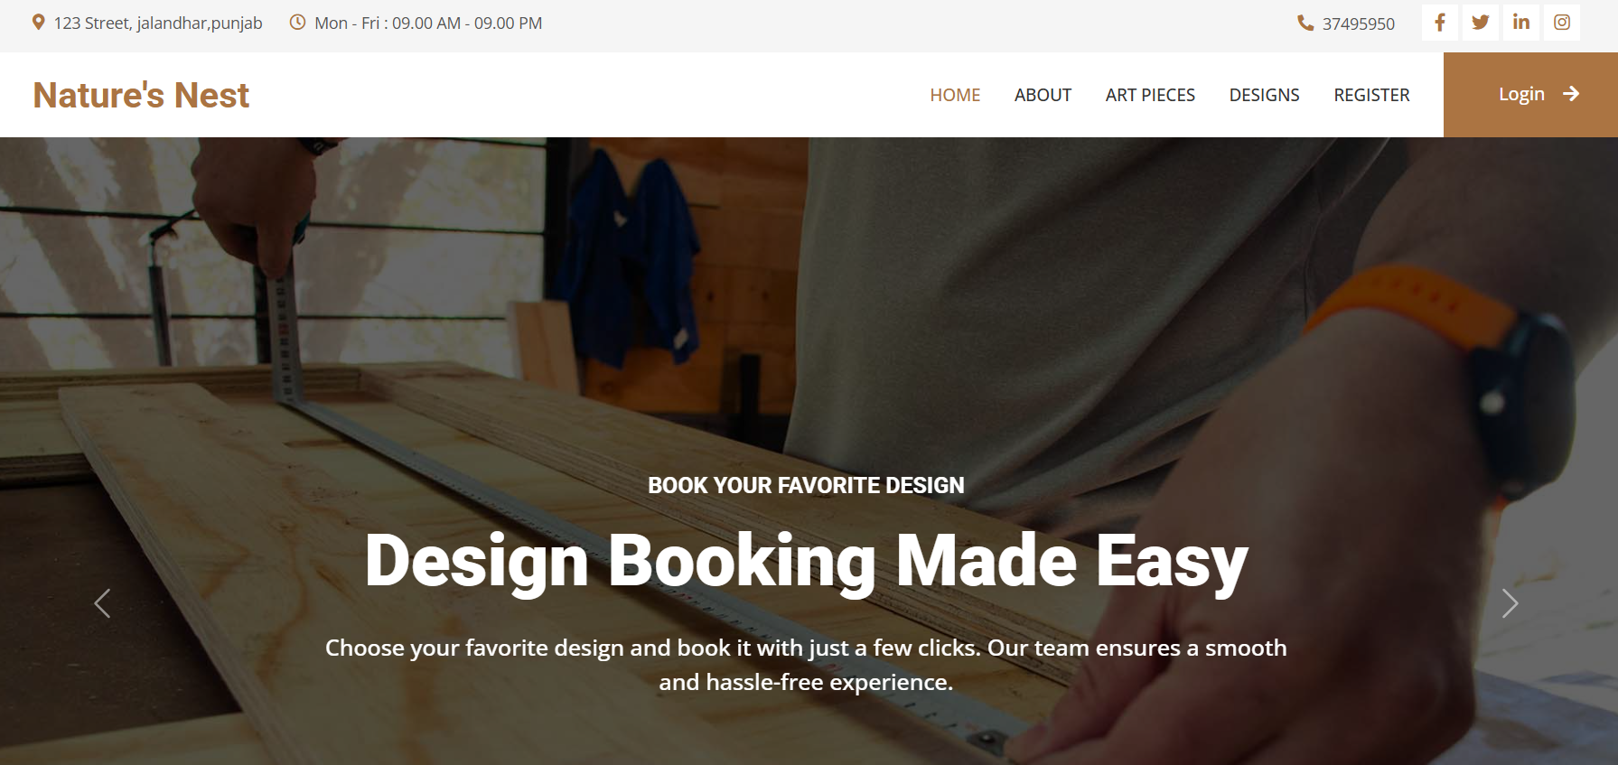
PROJECT VISUALS

Slide 17
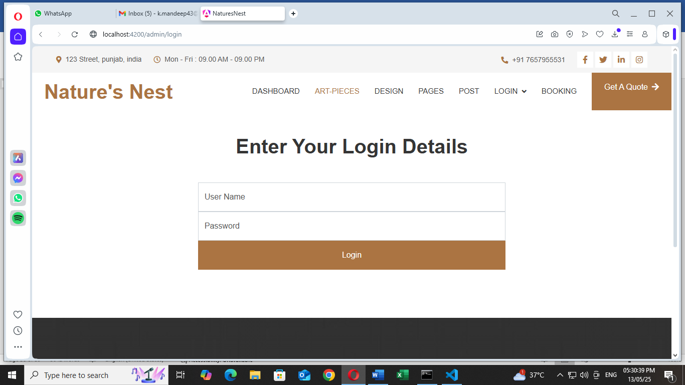
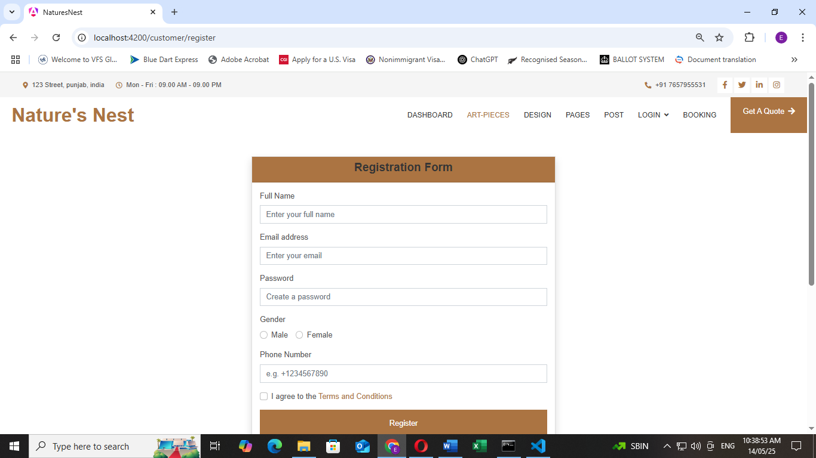
Login & Register

Slide 18
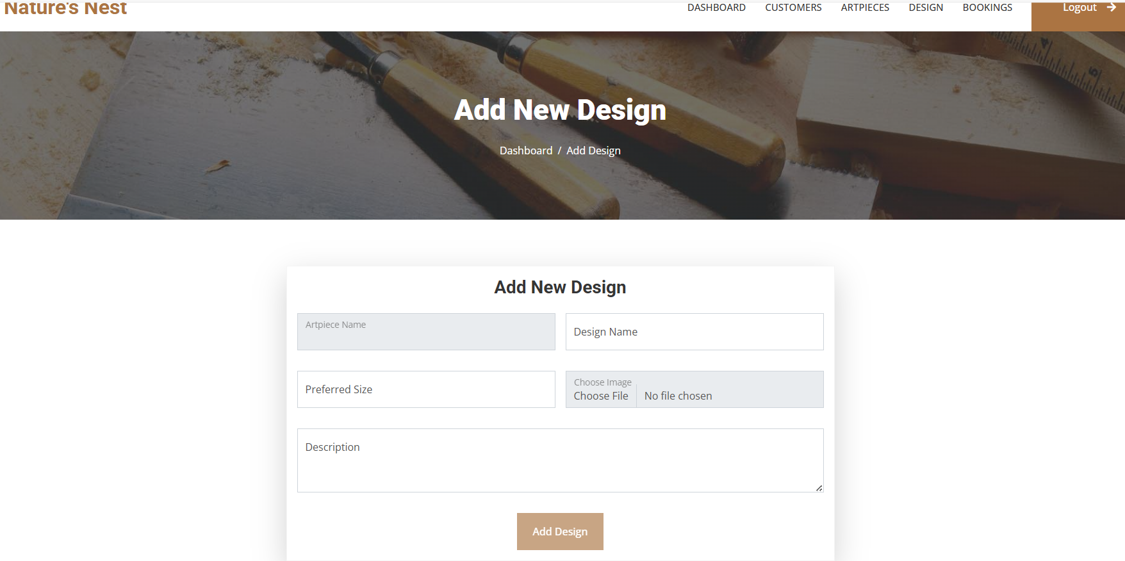
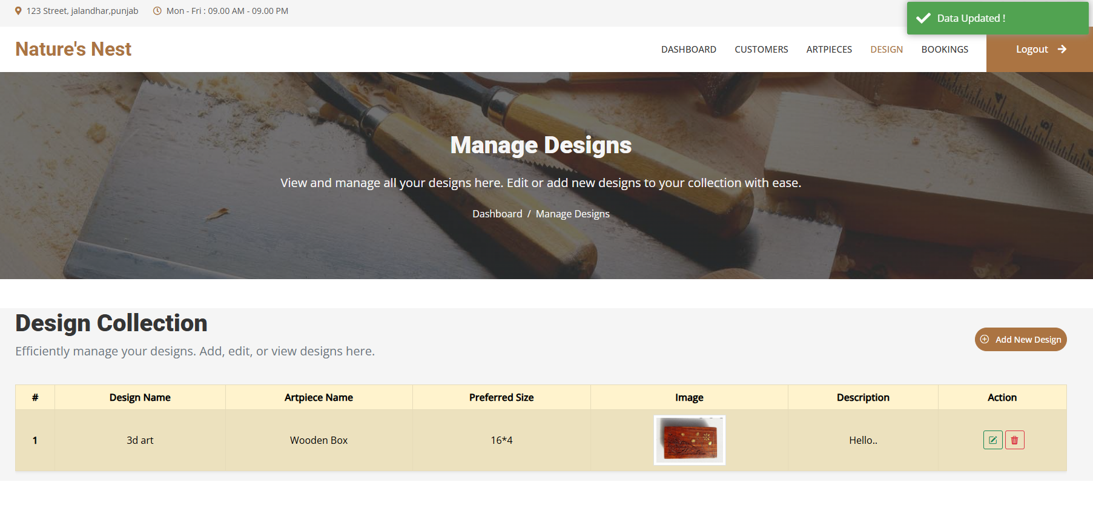
Designs

Slide 19
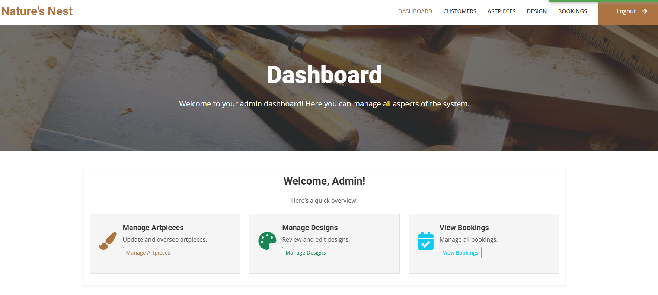
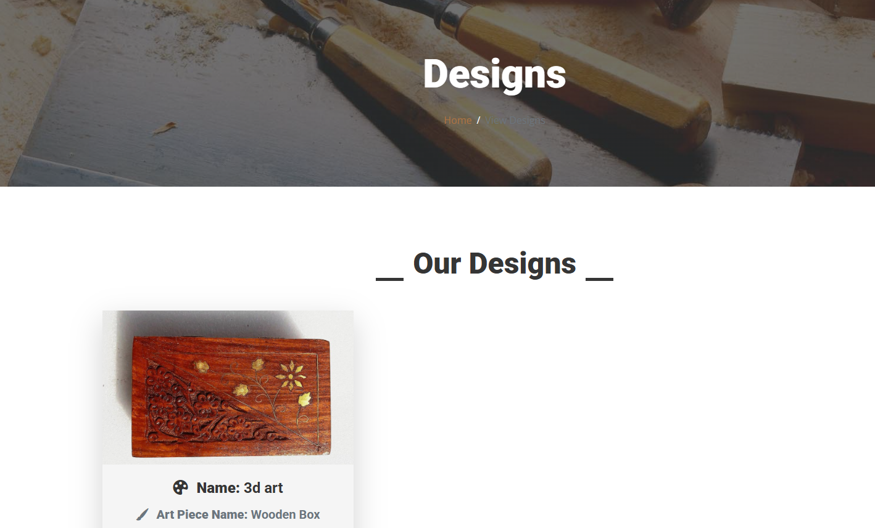
Dashboard & Design

Slide 20
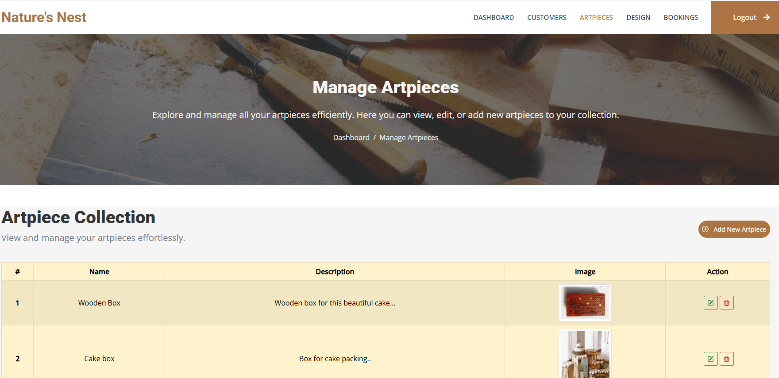
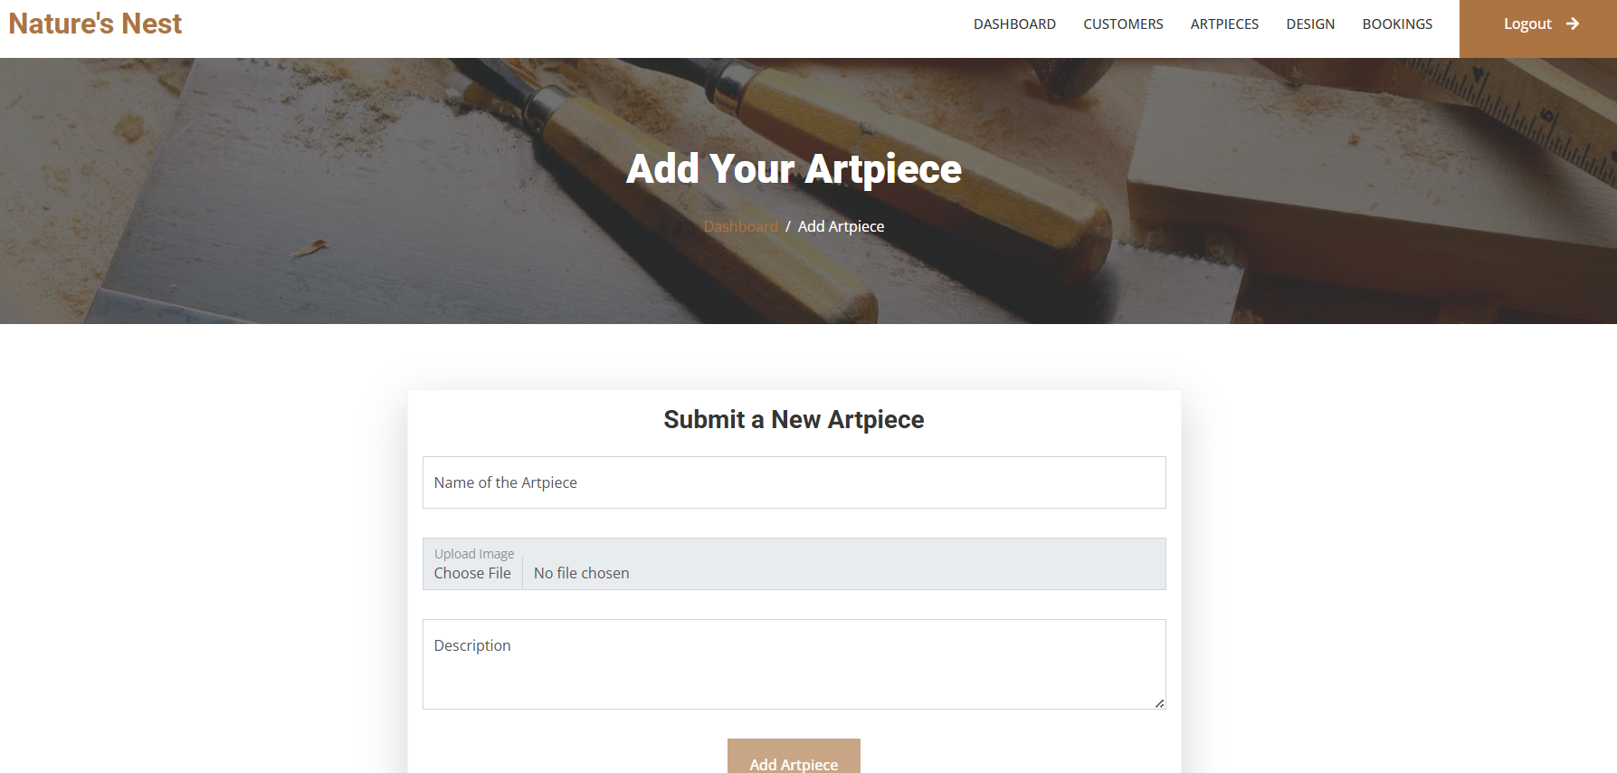
Art Piece

Slide 21
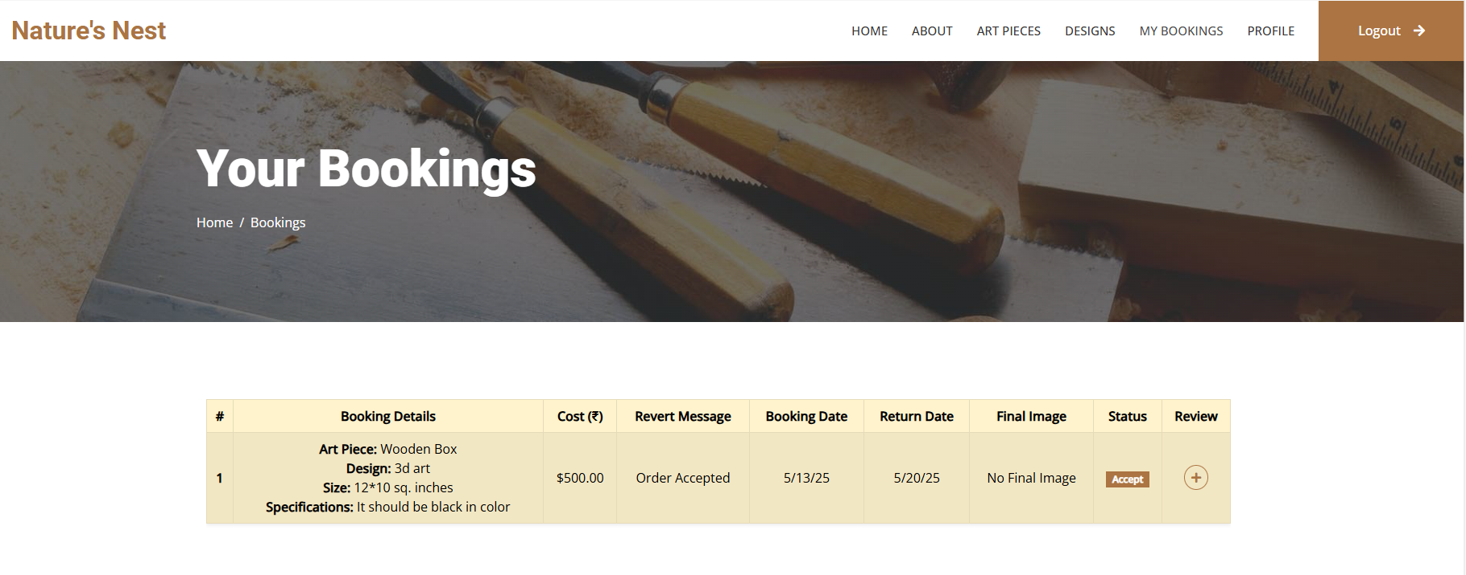
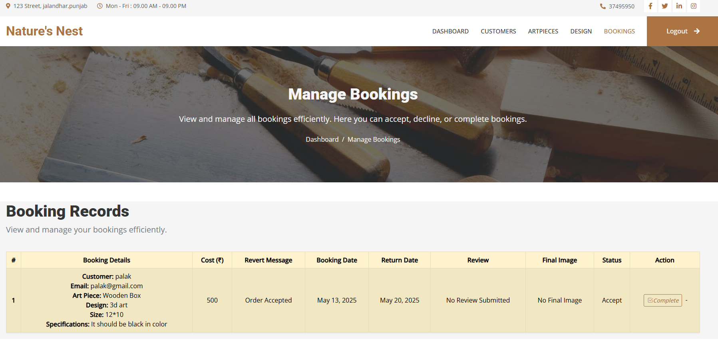
Booking

Slide 22
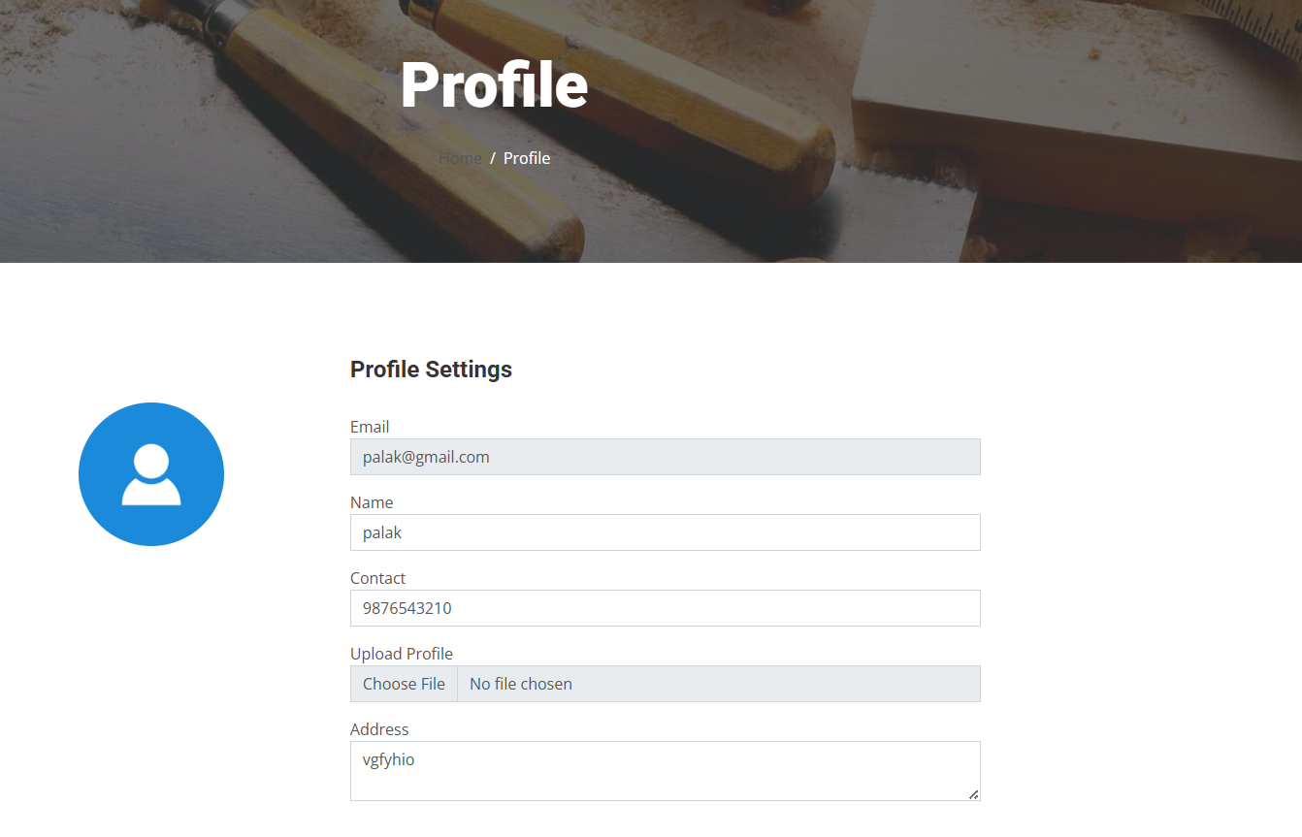
Profile

Slide 23


THE CRAFTSMANSHIP
PROCESS
Wood Selection
Design & Planning
Crafting
Finishing

Slide 24


CONCLUSION
Reflects towards unique Artistry of worker.
Holistic Integration of Art and technology
New innovations
Eco-Friendly materials used

Slide 25
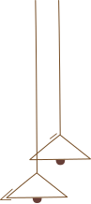

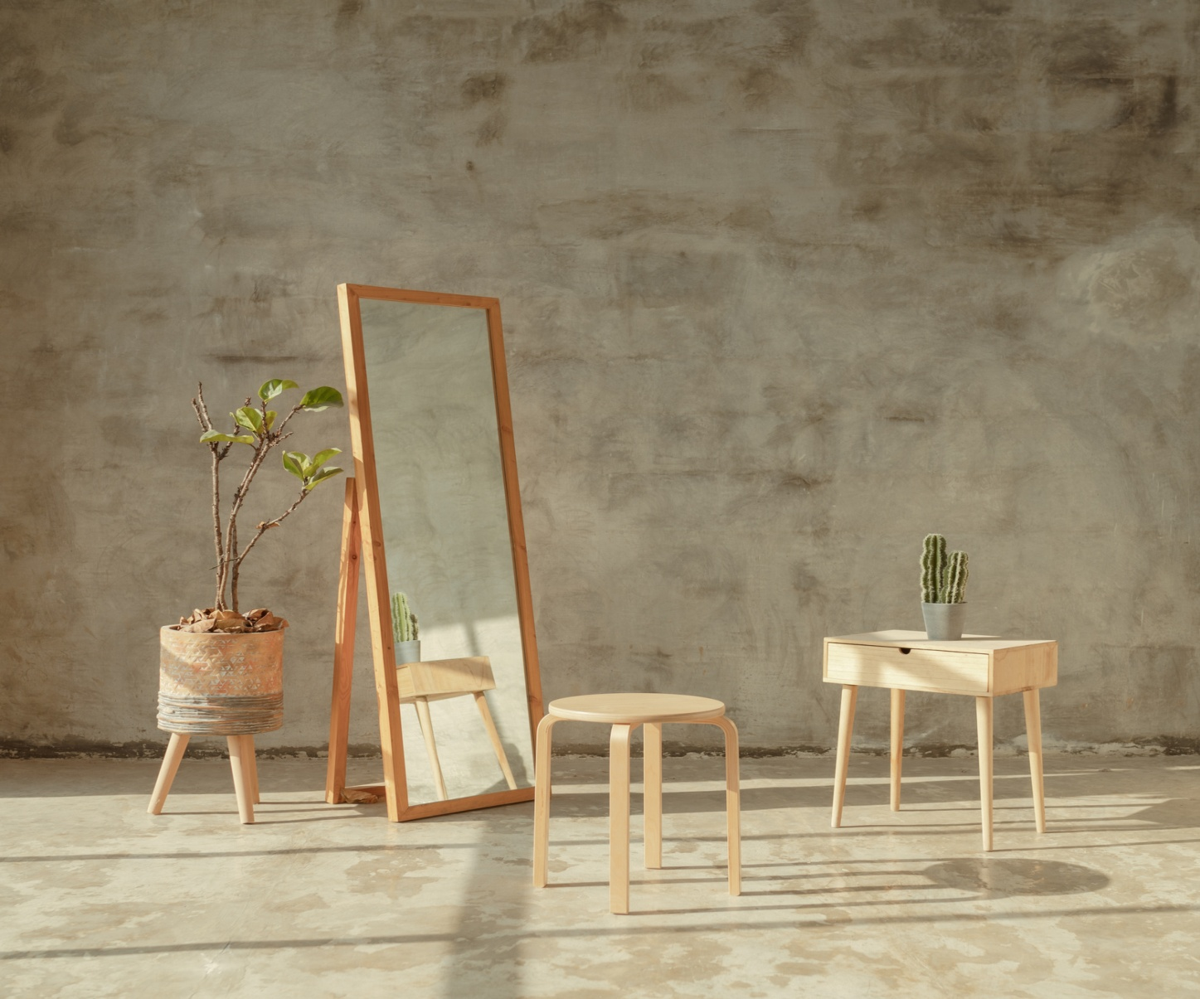
FUTURE SCOPE
Innovation in Design
Live chat & FAQ section
AI-Powered System
Virtual Exhibition and
Events

Slide 26
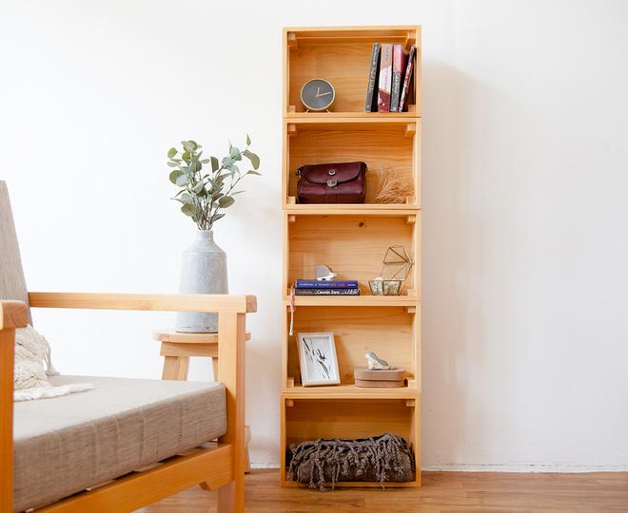

THANK YOU

